Slide 1

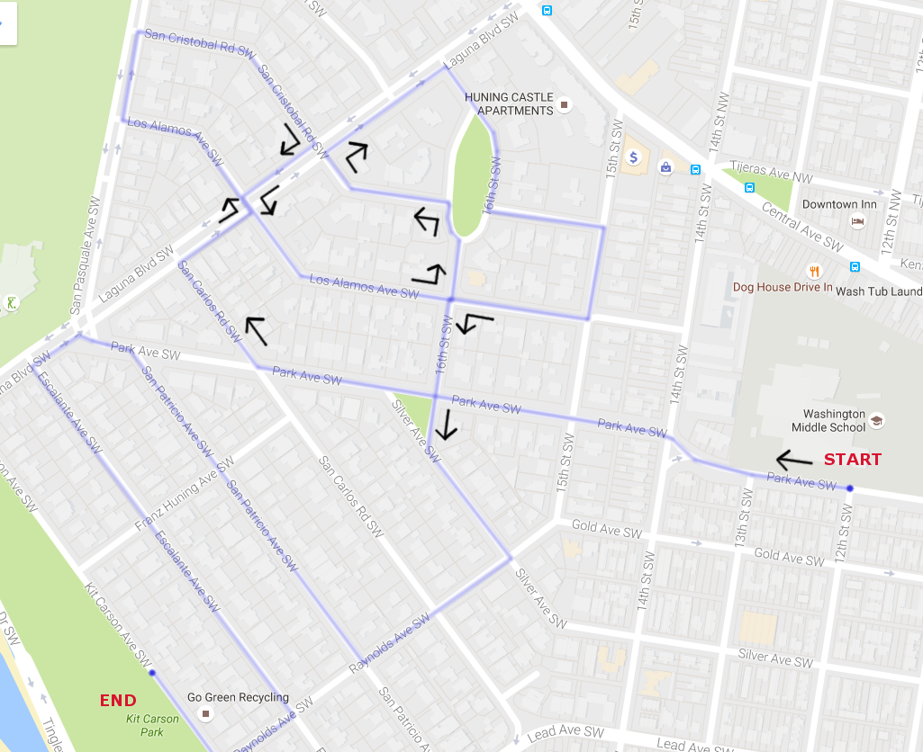


Albuquerque High School
Mighty Bulldog Marching Band
MARCH-A-THON
Saturday, September 8, 2018
9:00 am – 11:00 am
Thank you for your support!

